Slide 1

FPT Company Introduction
NGUYEN DUC QUYNH
Director
October 16, 2013

Slide 2
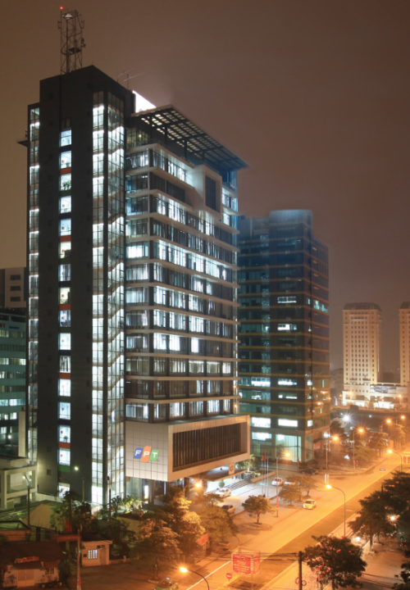
CORPORATE OVERVIEW
Historical
Milestone
2011 | Launching OneFPT Strategy
2010 | Changing Logo & Going mass
2008 | Reaching US$1billion revenue
2006 | Becoming an IPO
2002 | Privatizing
1999 | Globalizing
1996 | Rising to market leadership
1990 | Identifying core business – IT
1988 | Establishing
FPT Vision
FPT strives to be a company guided by technological innovations, committed to the highest level of customer satisfaction, contributing to national prosperity and providing its employees with the most favorable work environment possible, enabling them to reach their full potential in their professional careers as well as their spiritual lives.

Slide 3
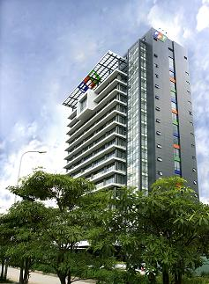
The market leader in Vietnam
FPT - the Market Leader
The leading ICT company in Vietnam
Founded in 1988
Public listed on
VNSE
Dec-06
Revenue 2012:
1.2 Billion US$
Nr. Of Employees
~ 15,000
FPT Information Systems
FPT Software
FPT Investment
FPT Telecom
FPT Trading
FPT Education
FPT

Slide 4
The market leader in Vietnam
Revenue and Staff Growth
1,200
1,200
Revenue (Millions USD)
1,190
Staff (Person)
1,100
1,027
15,000
868
13,000
12,300
727
12,000
9,344
9,027
517
7,008
324
204
5,000
110
3,000
2,045
1,100
2002
2003
2004
2005
2006
2007
2008
2009
2010
2011
2012

Slide 5


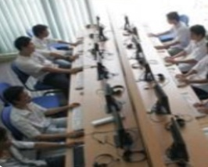
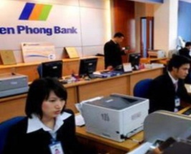

Our Core Business
Software Services and Systems Integration
7500 Employees
Application Development
ERP Lifecycle
Embedded Systems
Testing and Migration Services System Integration and Cloud
Infrastructure and Security
FPT Education
15000 Students
University : 6.000
Polytechnic: 4.700
FPT Aptech, Multimedia: 4.300
Telecommunications
4500 Employees
Cooperate Network Services
Consumer Network Services VOIP Solutions
Online Content
Online gaming
IT Products
1300 Employees
Distribution and Retail
Manufacturing (Desktops and Mobile Devices)
Banking / Finance
Internet and Mobile Banking

Slide 6
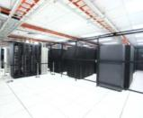


System Integration
Profile
Established: 1994
Staff: 2,356 (8/2012)
Revenue: 3,294 billion VND (12/2011)
Main Business
System Integration, Application Development, ERP Services, IT Services, BPO Services, Electronic processing services
FPT INFORMATION
SYSTEM
Achievements
SAO KHUE Award for FPT-CA (2012); Best software company with domestic software and services products (2011); VICTA Awards for Best company of Integrate Information Technology System (2010)
The highest rated partner of most major supplier over the world such as Cisco, IBM, Oracle, SAP, NCR…
“NUMBER 1 SYSTEM INTEGRATION & IT SERVICES PROVIDER IN VIETNAM”

Slide 7

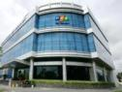
Telecom
Profile | Position | Achievements
FPT TELECOM
Established in | 1997
Revenue | 2,357 billion VND (12/2011)
Number of staff | 3,015 (8/2012)
Main business | Internet broadband Leased-line (IPLC/MPLS) Data services Voice
“PRESENCE IN
45 CITIES & PROVINCES IN VIETNAM”
“THE NUMBER 1 STORAGE SERVICES IN VIETNAM”
Sao Khue Award (2012) for:
The Best ADSL Service
The Best FTTH Services
The Best hosting and domain services
The Best Data Center Service

Slide 8

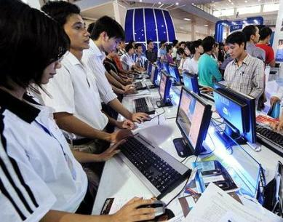








PROFILE
Digital content
Established in 2007
Revenue: 1,132 billion VND (12/2011)
Number of staff: 937 (8/2012)
Main businesses:
Online games; News& social network; Online advertising; Other online services: mobiles VAS, payment services, e-commerce
FPT ONLINE
NUMBER 1 IN ONLINE ADVERTISING
NUMBER 3 IN GAME ONLINES
DIGITAL CONTENT
Alexa rank 5
90 million page views/ month
ONLINE AD
Ad inventory management with
over 10 billion banner impressions/month
GAME ONLINE
Sao Khue Award for BKool game online

Slide 9
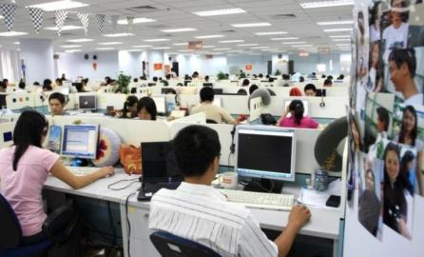
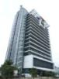
Software outsourcing
Profile | Position | Achievements
FPT SOFTWARE
Established in | 1999
Revenue | 1,881 billion VND (12/2011)
Number of software engineers | 4,563 (8/2012)
Main business | Software development & maintenance Embedded software solution Migration, quality assurance & testing
“GLOBAL APPROACH
WITH 9 REPRESENTACTIVE OFFICES OVER THE WORLD”
“THE NUMBER 1 SOFTWARE OUTSOURCING IN VIETNAM”
TOP 100 Global Outsourcing (2012) (voted by Global Services & NeoGroup)
VICTA Awards for Best Product & Best Export Service Provider (2011)
ICT Awards for Best Software, Best Management Processes & Highest Revenue Enterprise (2009)
ICT Awards for Best Software Enterprise (2010)

Slide 10
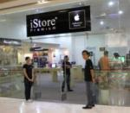
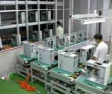

Distribution& Manufacturing
Profile
Established: 1993
Revenue: 16,309 billion VND (12/2011)
Staff: 1,115 (8/2012)
Main businesses:
ICT products manufacturing
Mobile distribution
IT distribution
FPT
TRADING
Achievements
VICTA Awards for FPT Elead as the best domestic computer brand (2011)
Vietnam ICT Awards: The best ICT & Mobile Distributor (2010)
“NUMBER 1 IN INFORMATION & COMMUNICATION TECHNOLOGY PRODUCTS DISTRIBUTION”

Slide 11


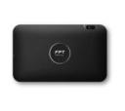

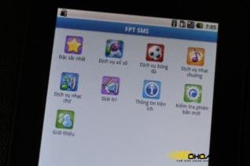



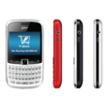




FPT Trading
Our Distribution
Our Products
FStore
Largest network: 1000+ agencies in 63 cities in VN.
Distributor for more than 60 international firms.
Manufacture handset, laptop, tablets.
Run in-house App store named FStore.

Slide 12
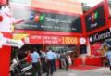
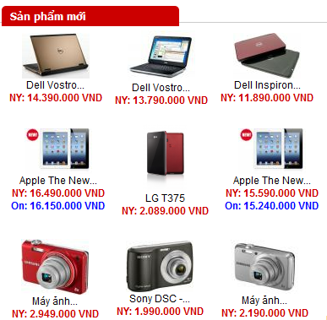
Retail
Profile | Goals
FPT
RETAIL
Established in | 2012
Number of staff | 724 (8/2012)
Main business | Selling: Portable ICT products (mobile handset, laptop, tablet, camera, accessories…) Apple Store
fptshop.com.vn
19 SHOPS (12/2011) – 43 SHOPS (09/2012) – 53 SHOPS (12/2012)
Setting up a chain of 150 retail shops within the next two years.
Investment estimated: VND 250 billion.
Revenue is expected to reach approximately VND 5,000 billion in 2015.

Slide 13


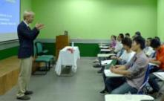
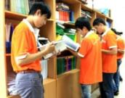


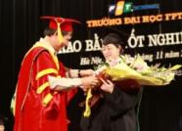
Education
Profile
Established in 2006
Headquarters: Hanoi, Vietnam
Number of students: 15,000
Training programs:
Bachelor of Software Engineer, Finance & banking, Business Administration Programmers International, Multimedia Art
MBA, MiniMBA
FPT
EDUCATION
“THE BEST SUPPLIER OF IT HUMAN RESOURCES TRAINING SERVICES” (MINISTRY OF IT&COMUNICATION AWARD 2011)
VINASA Awards for formal and non-formal training services (2012)

Slide 14
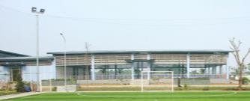
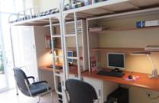
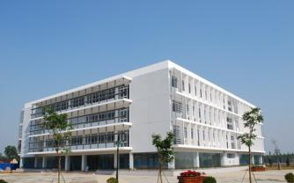
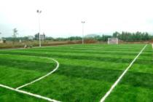
FPT EDUCATION
FPT University
FPT Polytechnic
FPT
Aptech
FPT
Arena
FPT
School of Business
6,000 students at bachelor degree (72% software engineering)
60,000 students trained in other areas of training (Aptech, Arena, Top-up…) since 1999
Campus: Hanoi, Da Nang & HCM City and new 60 hectare campus is being constructed in Hanoi, Da Nang

Slide 15
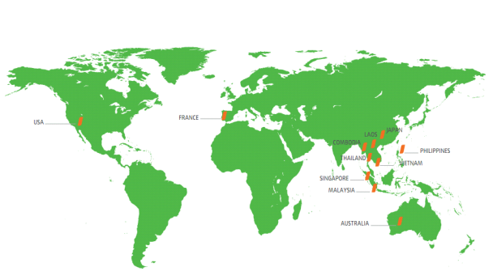
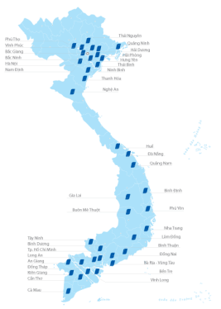
FPT Presence
11
45
countries
over the world
cities & provinces in Vietnam

Slide 16
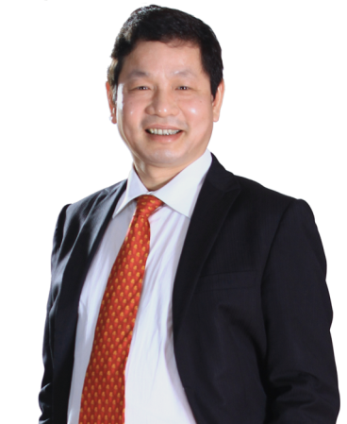
Phase 3
FPT must become
A Leading Global Corporation in Vietnam
Globalization
2020 - 2024
Phase 2
Leading
Stand in the Top 500 enterprises of Forbes Global 2000 (Forbes Magazine)
2015 - 2019
Move to a leading position of Vietnamese enterprises
3
Phase 1
Positioning
2011 - 2014
Establish an important position in the national ICT infrastructure, economy and social of Vietnam.
2
1
Focus on core businesses in ICT Industry with 3 main directions:
Go Mass – Synergy - Best-in-class

Slide 17

FPT Software
The Software Power House

Slide 18
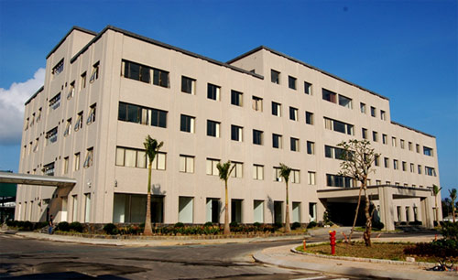
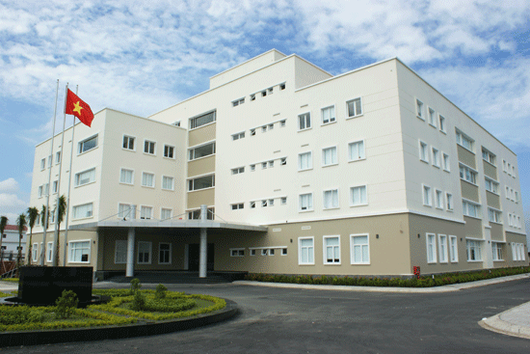
The Software Power House
FPT Software - the Software Power House
Vietnam’s largest and one of the fastest growing Software outsourcing companies.
Founded in 1988
Revenue 2012:
81.5 Million US$
Nr. Of Employees
4,100
FPT Danang Building
F-Town Building
CMMI 5 BS 7799
ISO 27001 : 2005
ISO 9001 : 2008
CMMI 5 v1.2
Quality
CMM 4
CMM 5
ISO 9001
2000
2002
2004
2006
2007
2009
2011

Slide 19
The Software Power House
Revenue and Staff Growth
81.5
Revenue (Millions USD)
Staff (Person)
62.5
4,100
3,100
3,100
52
2,700
2,700
2,300
42
42
1,700
29.6
1,000
16.6
9.2
2005
2006
2007
2008
2009
2010
2011
2012

Slide 20
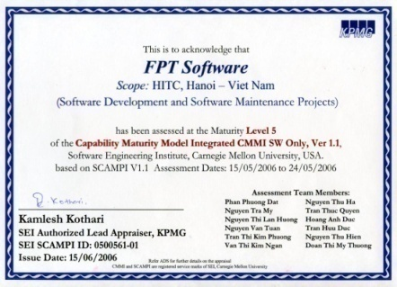
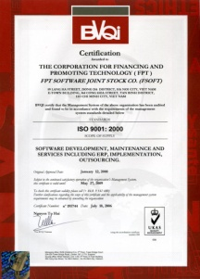
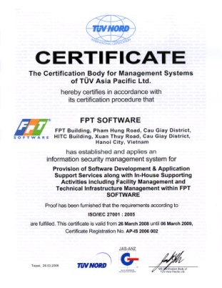






Certified for highest Quality and Security Standards
Best in Class Processes
FPT chooses world-class standards and models to benchmark against such as SEI CMMI Level 5; ISO 9001:2008; and ISO/ TS 16949
Security Standards
We are the first company in Vietnam to implement the BS 7799-2:2002 standard for Information Security Management System
(now ISO 27001:2005)
To protect our client’s
intellectual property and ensure secure offshore operations.
Internationally Recognized
Partnering and certified by these Partners

Slide 21
The Software Power House
FPT Software
Domestic Branches
FPT Software Ho Chi Minh City
Overseas Branches
FPT Software Da Nang
Development Units
FPT Japan
FSU1
FPT USA
FPT Europe GmbH
FSU 3
FPT Software Europe Ltd
FSU 11
Asia Pacific
FPT Asia Pacific
FSU 15
FPT Software Malaysia
FSU 17
FSU (FPT Software Strategy Unit)
Market, Service or Client focused
FPT Australasia

Slide 22
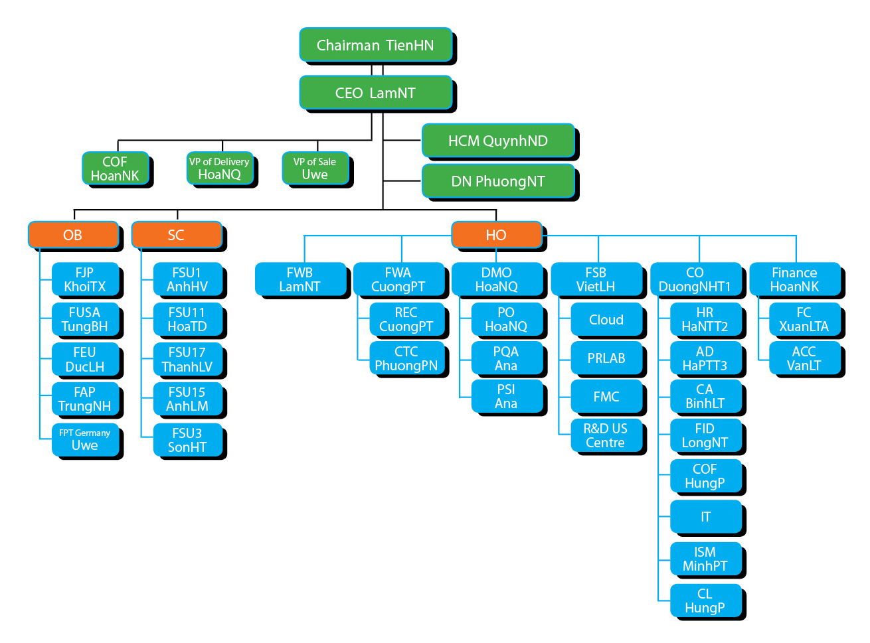
The Software Power House

Slide 23

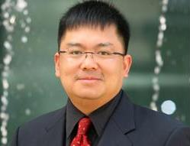


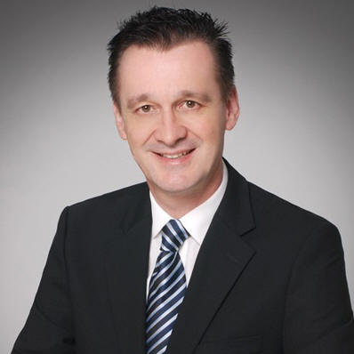

The Software Power House
Chairman
(TienHN)
HR: 5000
Revenue: 100M USD
CEO
(LamNT)
2013 target
CFO
(HoanNK)
VP of Sales
(Uwe Schlager)
VP Delivery-
sản xuất
(HoaNQ)
© Copyright 2012 FPT Software
23

Slide 24

Global Presence
We are where our customers are
Japan
Tokyo
Osaka
EU
Paris
London
Berlin
Vietnam
Hanoi
Danang
Ho Chi Minh City
USA
California
New York
Texas
Oregon
Minnesota
Thailand
Malaysia
Philippines
Singapore
Australia
© Copyright 2012 FPT Software
24

Slide 25



Global Presence
We are where our customers are
Japan
Tokyo
Osaka
EU
Vietnam
Hanoi
Danang
Ho Chi Minh City
USA
California
New York
Texas
Oregon
Minnesota
Malaysia
Australia
© Copyright 2012 FPT Software
25

Slide 26





























Professional IT Services from your trusted Partner
Our Clients and Partners:

Slide 27
Professional Services from your trusted Partner
Application Services
Embedded Systems
BPO Services
Testing Services
ERP Solutions and Services
Migrations Services
Mobility Services

Slide 28
Software Process
Our Quality
Management System complies with international quality standards: CMMI5, ISO 9001:2008.
Management Suite is a collection of internal tools for project management allowing customers to use remote access to track and manage projects.
Timesheet: for all project members to record their time and effort spent.
DMS (Defect Management System): for QA people and project leaders to collect and manage defects raised to software products.
Fsoft Insight: for project managers to plan, track and monitor projects. Effort and defect data from Timesheet and DMS is automatically linked to Fsoft Insight for quantitative management.
Dash Board: for senior managers to overview the status of projects, and manage HR.
© Copyright 2012 FPT Software
28

Slide 29
Our people
Largest pool of SW engineers in Vietnam: > 3,000
Average age: 27
Comprehensive training process
15 days training/year for each staff
Investment in BrSE, PM training
Reliable sources of IT human resources
90% from top IT universities in Vietnam
FPT University
Multiple foreign language skills
English is compulsory
Japanese is majority
French, Chinese, Germany etc. is required upon request
Our talent comes from
FPT Software
Qualified for new project
6 month Internship
Program
OPERATION
GROUP
Universities across the nation, including:
Top IT universities in Vietnam
FPT University
FPT Aptech
and Overseas universities
Day One
PROJECT
PROJECT COMPLETED
3 month Training
Update new Technologies
Advanced software process courses
Wider range of development technologies
Project management exam
and certification
Training Center
Update new skills
High profile candidates
© Copyright 2012 FPT Software
29

Slide 30
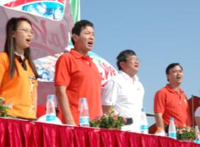


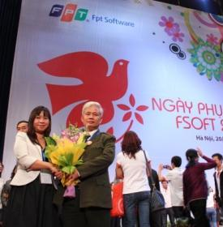

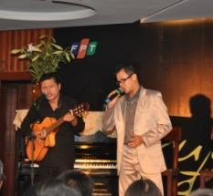

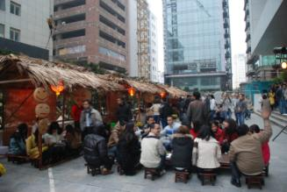
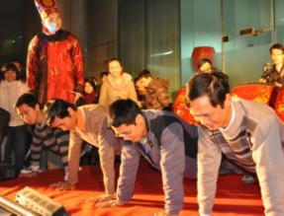
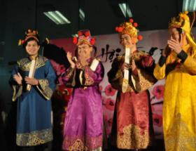
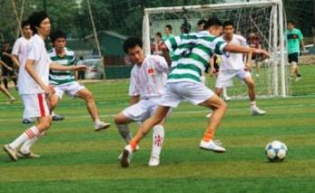
13.9
Company’s birthday
Sport day
Gala night
Parents day
FPT CORPORATE CULTURE
Friday on 13th Floor
FPT/FSOFT CORPORATE CULTURE
Individual Respect
Innovation
Teamwork
Dedication
Exemplariness
Perspicacity
Village Festival
Favorite Clubs
Miss FPT

Slide 31

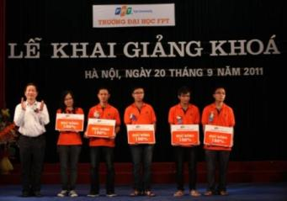

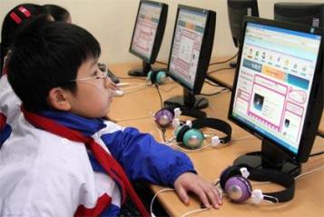
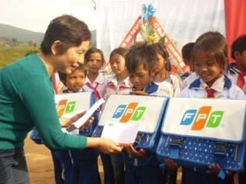
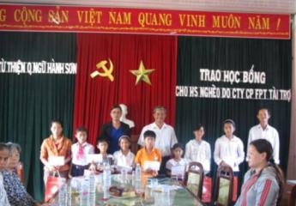
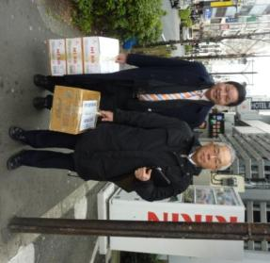
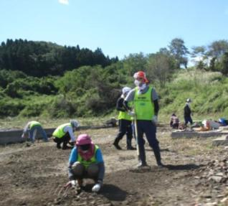
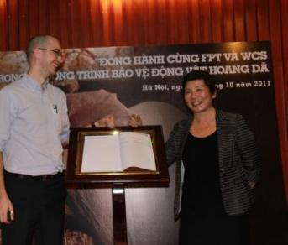
Rising Vietnamese intellectual
13.3 - FPT
Community’s day
Encouraging Young Talents
Chim En Award
CORPORATE
SOCIAL RESPONSIBILITY
CORPORATE
SOCIAL RESPONSIBILITY
ViOlympic Mathematic contest
Scholar-ships
Charity
Environ-mental protection
Green company

Slide 32



